Slide 1
The News App
Vlad Adrian Dumitriu

Slide 2
Introduction and Mobile features / Framework
The aim is to create a prototype App that can deliver news from different sources to Android
User will be able to find different news, including the hot ones, from multiple sources
WEB SERVICE: The app uses News Api from https://newsapi.org and it has access to multiple sources

Slide 3
Design PAttern
For the app has been used 3 different designs , for 3 different activities:
-First, for the main page, to load all the news sources
-Second, to display the hot news and the others from the source
-Third, to display the article to read

Slide 4
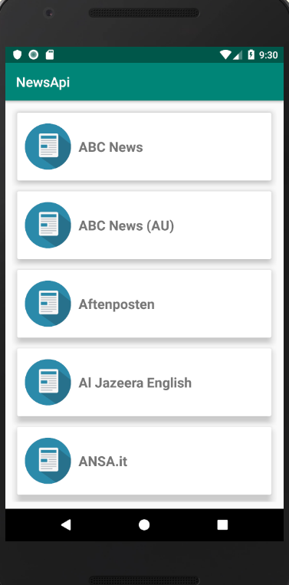
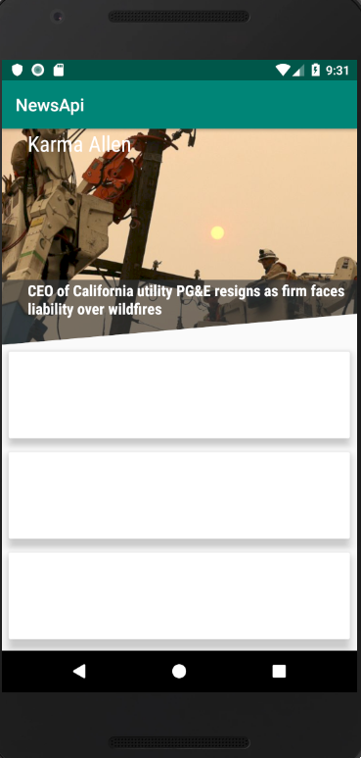
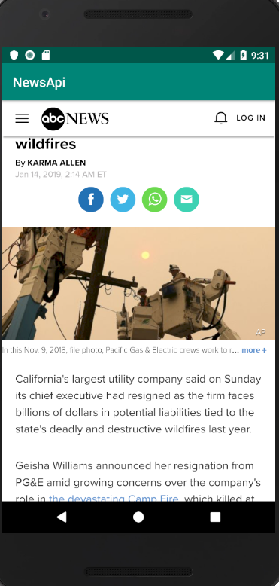
Design

Slide 5
Libraries used and language
The language used has been Kotlin
Libraries:
-Retrofit , to get the API working
-Recycler View, to display a scrolling list of news
-Card View, to border the news and the sources
-GSon to use Java Objects
-Picasso to load images from URL
-Diagonal Layout to make the Ken Burns effect on the hot news
-Paper for a simple and fast object storage option in Android
-Alert Dialog for the loading animation with dots

Slide 6
Problems Encountered
Time to display in every news not working
Other news from the second activity are not showing, just the “hot news” from every source

